Slide 1



Regional Energy Integration – Vision and Barriers:
North American Power Markets
Dan Scripps, Chair
Michigan Public Service Commission
22 September 2026

Slide 2
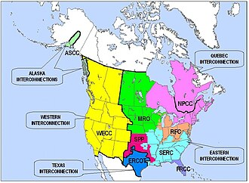
Overview of the North American power system
North American power system made up of two primary and three secondary electrical interconnections
  Eastern Interconnection
  Western Interconnection
  Quebec Interconnection
  Texas Interconnection
  Alaska Interconnections
Utilities within each interconnection are electrically tied and operate at synchronized frequency (60 Hz)
Interconnections tied together with HVDC ties or variable-frequency transformers
  Ties permit a controlled flow of energy while also functionally isolating the independent AC frequencies of each side

Slide 3
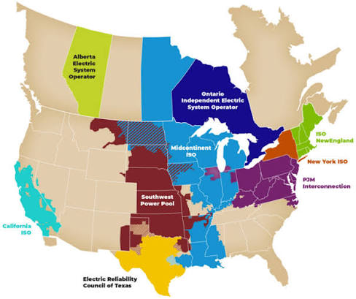
Development of RTOs/ ISOs in North America
Starting in mid-1990s, regulators in the US and Canada began to push for non-discriminatory access to transmission services and the creation of wholesale electricity markets
In some cases, Independent Transmission Operators (ISOs) and Regional Transmission Organizations (RTOs) built and expanded on existing power pools; in others, they were new creations entirely
North American wholesale energy markets developed in parallel to RTOs/ ISOs and are typically run by the RTO
However, not all areas of the US and Canada have RTOs/ ISOs or wholesale energy markets

Slide 4

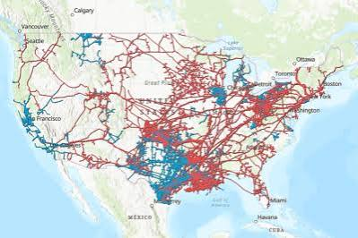
Applicable regulatory frameworks - US
Beginning in 1980s in the natural gas industry, the US Federal Energy Regulatory Commission (FERC) began steps to further anti-discrimination goals
  FERC Order 436 – issued in 1985
    Allowed interstate pipelines to offer transportation-only service
    Prohibited pipeline operators from discriminating against transportation requests based on protecting own merchant services
    Eventually, transportation function became the primary function of pipelines, as opposed to offering bundled merchant service
  FERC Order 636 – issued in 1992
    Removed voluntary elements of Order 436; required separation of transportation and sales services and restructuring of companies
    Affiliates prohibited from having advantage (in terms of price, volume, or timing of gas transportation) over other potential users
    Also requires transparency of information on available capacity via electronic bulletin boards accessible by all customers on an equal basis

Slide 5

Applicable regulatory frameworks - US
In 1996, FERC adopted similar framework for electric transmission through Orders 888/ 889
  FERC Order 888
    Requires all public utilities to file tariffs providing nondiscriminatory electric transmission access to all wholesale users
  FERC Order 889
    Requires transmission owners to make available an electronic bulletin board to share information – called an Open Access Same-time Information System (OASIS)
Orders 888 and 889 represent “functional unbundling”; to date FERC has not required the same “operational unbundling” that it did for natural gas industry
Order 888 also suggested the creation of ISOs to promote wholesale competition for electricity supply and non-discriminatory access to transmission services, outlining 11 core principles for their structure

Slide 6







Applicable regulatory frameworks - US
In 1999, FERC took additional step to encourage development of RTOs through Order 2000
  In addition to ISO roles outlined in Order 888, Order 2000 encourages RTOs to engage in regional transmission planning and energy trading and coordination
    By treating the whole of the transmission system overseen by an RTO as a single grid, avoids buyers and sellers of electricity having to pay separate charges to each transmission owner
Today, six FERC-regulated RTOs exist in the US, as well as the Electric Reliability Corporation of Texas, which functions as an RTO but is not subject to FERC jurisdiction
These RTOs/ISOs administer a number of markets:
  Day-ahead electricity markets
  Real-time electricity markets
  Capacity markets (ISO-NE; MISO; NY ISO; and PJM)
  Ancillary services markets

Slide 7


Applicable regulatory frameworks - Canada
In Canada, the provinces of Alberta and Ontario also have established electric system operators
The Ontario Independent Electric System Operator (IESO) was established in the Electricity Act, 1998
  Operates day-ahead, real-time, and ancillary services market
  Also oversees annual Capacity Auction alongside bilateral contracts
The Alberta Electric System Operator (AESO) was established through the Electric Utilities Act of 2003
  AESO operates real-time (hour-ahead) electricity market and limited ancillary services market
  Last year, AESO announced the Restructured Energy Market (REM), to be implanted in mid-2027
  Key elements of REM include locational marginal pricing for generators, revised price caps, ramping reserves, day-ahead market for operating reserves, and the ability to commit generation assets during times of anticipated supply shortfalls

Slide 8
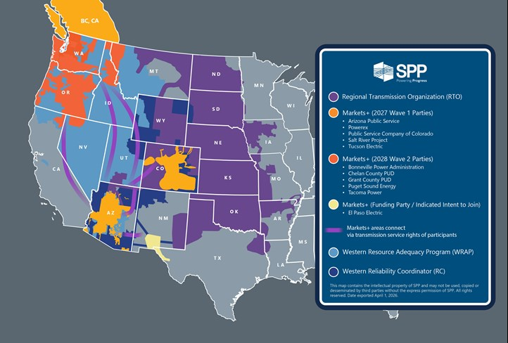
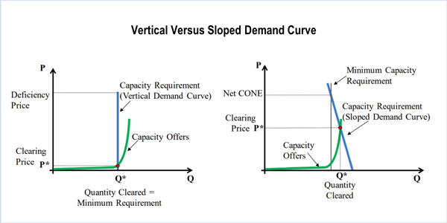
Emerging issues in NA power markets
SPP Markets+ initiative
  Day-ahead and real-time wholesale market developed by SPP and Western utilities – set to launch Oct. 2027
  Under Markets+, utilities do not transfer operational control of their assets or join the SPP RTO
  Complements – and in some cases competes with – other Western initiatives, such as CAISO Energy Imbalance Market (EIM) and Enhanced Day-Ahead Market (EDAM)
Declining reserve margins and RTO responses
  RTO reserve margins have declined as older, more costly generation has been retired
  Concerns have been raised about whether sufficient capacity exists to maintain resource adequacy
  In response, RTOs have added a range of market products:
    PJM: Reliability Backstop Procurement
    MISO: Reliability-Based Demand Curve
    ERCOT: Real-Time Co-optimization Plus Batteries

Slide 9
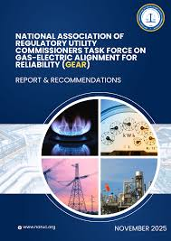
Key challenges facing NA power markets
Interregional connectivity and market synchronization
  Differences in market design among RTOs create barriers to efficient transactions across market seams and interregional planning
Harmonization of gas and electric markets
  Multiple organizations have undertaken investigations and proposed recommendations to improve coordination between the US gas and electric industries, including reforms to gas and electric markets
Growth of data centers and large loads
  Rapid growth of data center development has resulted in higher energy and capacity costs in wholesale markets (and elsewhere)
  In response, FERC directed RTOs to justify or reform their tariffs regarding how data centers and other large energy users connect to the transmission grid and how costs are allocated
  States also working to ensure safeguards against cost shifting to residential and other existing customers, including through RTO engagement

Slide 10


Key takeaways
RTOs in North America were created at a time of high reserve margins that resulted in excess costs
Accelerating pace of energy transition, emergence of load growth, and growing concern over energy affordability make markets and market discipline more important than ever
RTOs are recognizing these new and emerging realities, and taking steps to change pricing signals and expand market offerings in response
Difficult to separate market design questions from physical realities of the grid
Image: Curbed Detroit
Image: National Park Service

Slide 11
Dan Scripps
Michigan Public Service Commission
Email: scrippsd1@michigan.gov

